Slide 1
smarter Surveillance System
HCKPS04 - UPES CSI
Team Black Pearl

Slide 2
Problem Description
At present, a lot of man-hours are spent on physical patrolling of border areas and compounds.
Fencing wires are not reliable and easy to breach.
In large areas, it is difficult to be available at all locations.
If someone is breaching in absence of a guard, the guard will know only when they reach the breach site.
It takes a lot of time to cover the compound walls if the area is large.

Slide 3
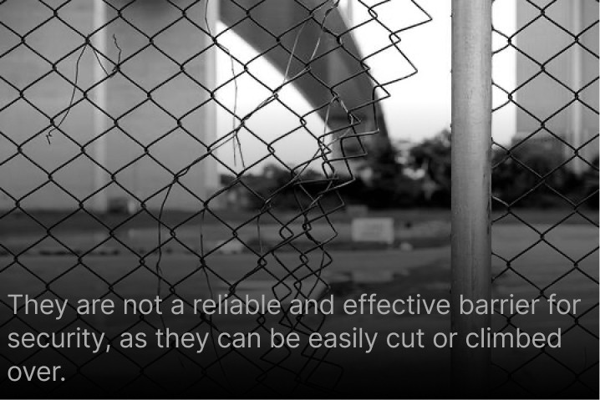
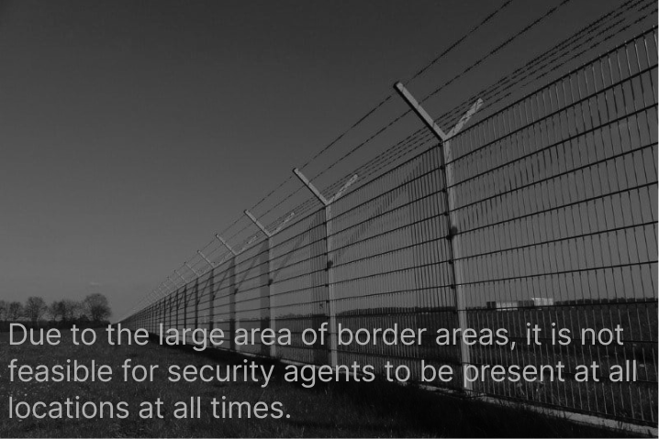
current Challenges
1.Fencing wires are not reliable and easy to breach.
2. In large areas, it is difficult to be available at all locations.

Slide 4

Objectives
A clear overview of the objectives for the Smarter Surveillance System :
To develop an tool that can monitor fence and borderlines in the most accurate and efficient way.
To develop a system that can detect and alarm in case of any breach or movement.
To create a modular design that is easy to assemble onsite and can be customised based on specific security needs.
To provide a centralised control room that can track and monitor the entire border area.
To reduce the number of man-hours spent on physical patrolling of border areas and compounds.

Slide 5
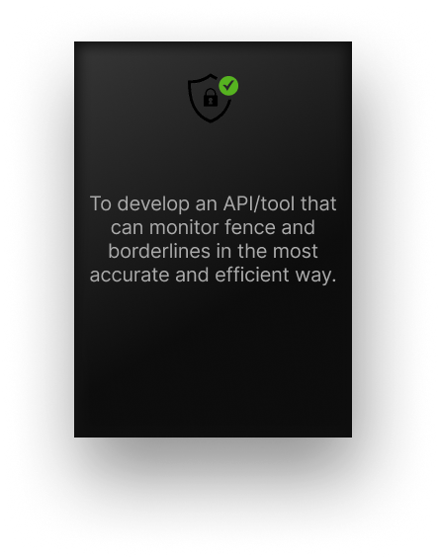
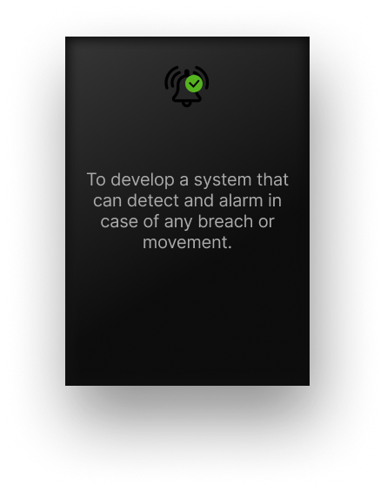

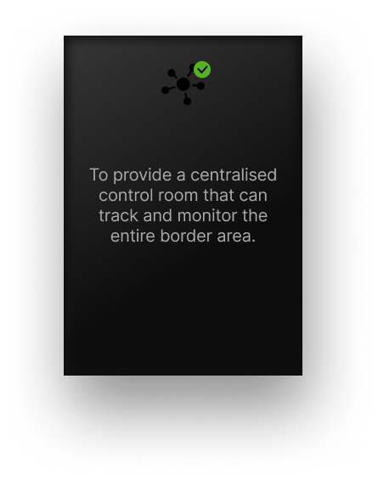
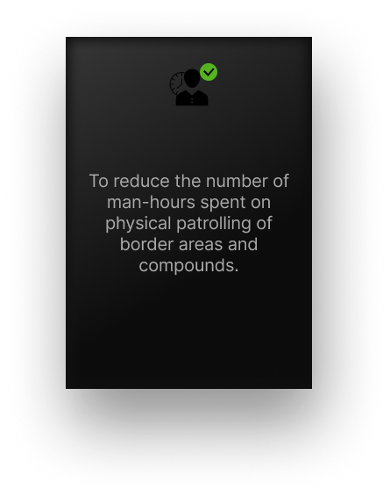
Objectives
Here is a clear overview of the objectives for the Smarter Surveillance System :

Slide 6
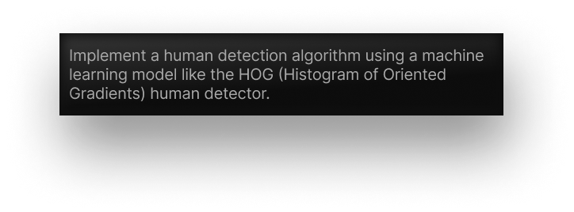
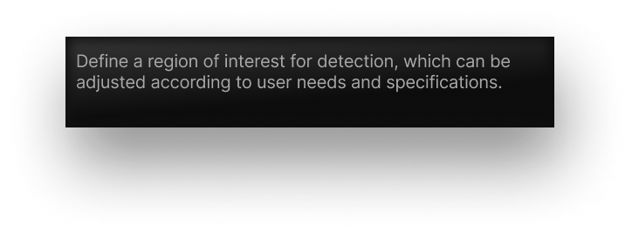


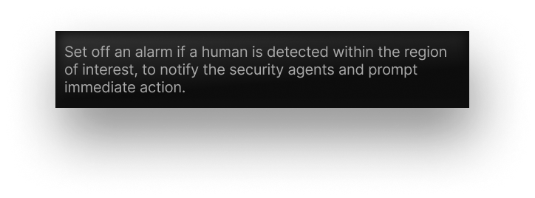
Proposed solution

Slide 7
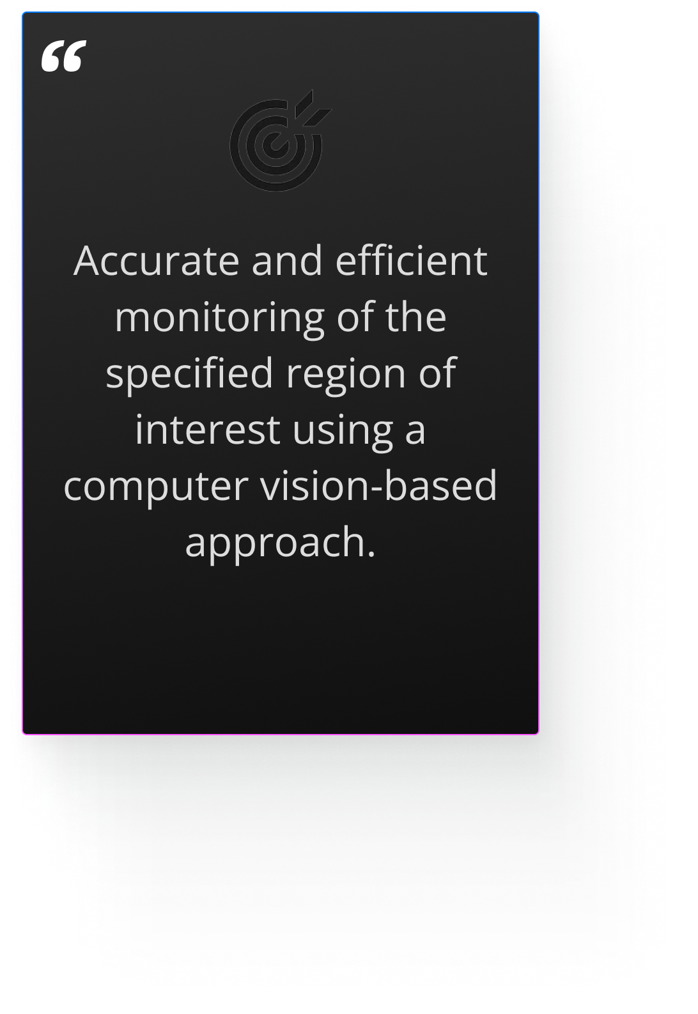
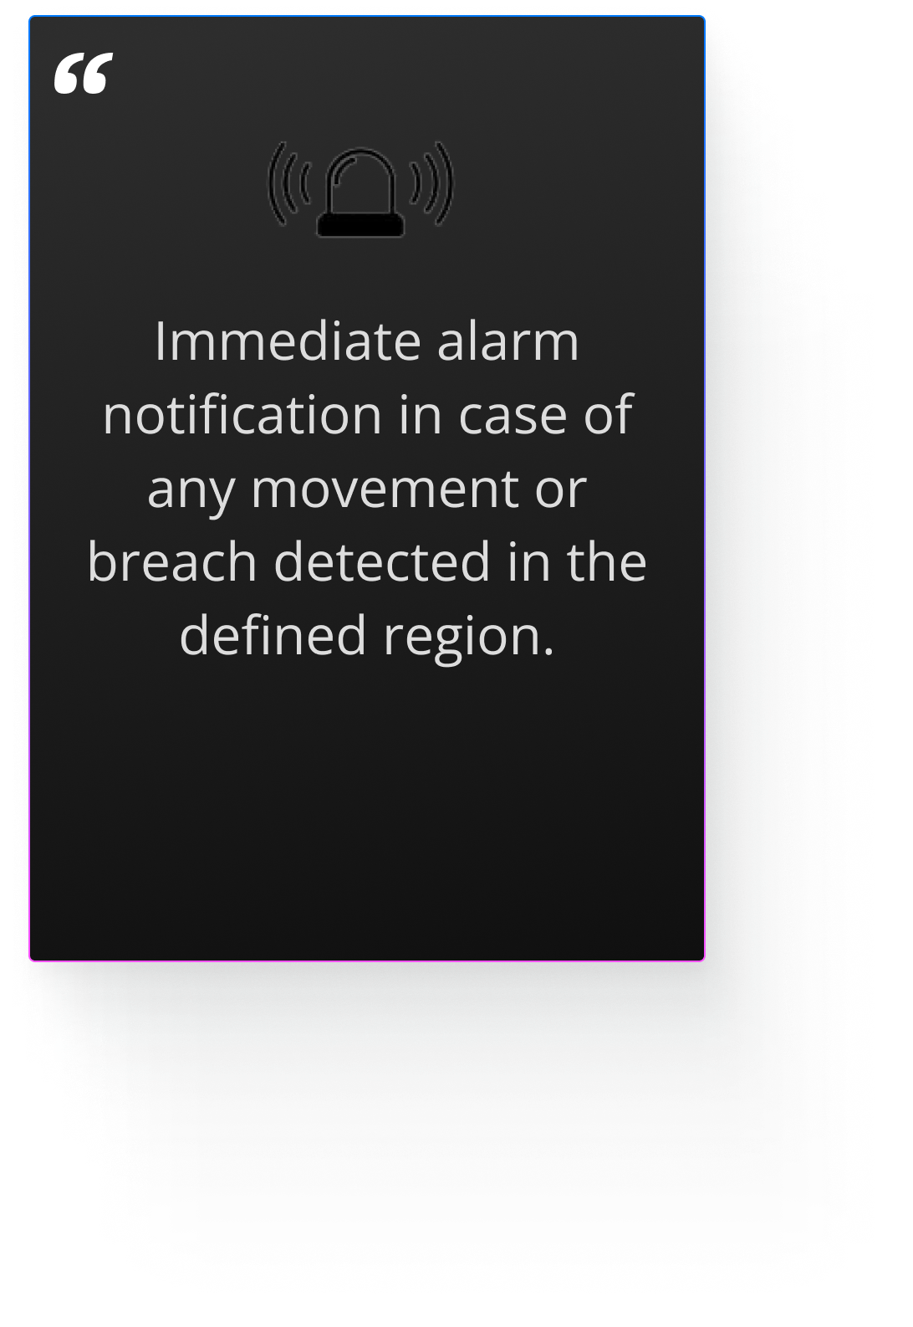

Expected outcomes

Slide 8
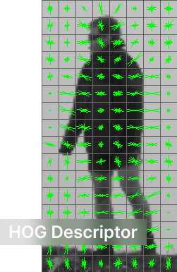
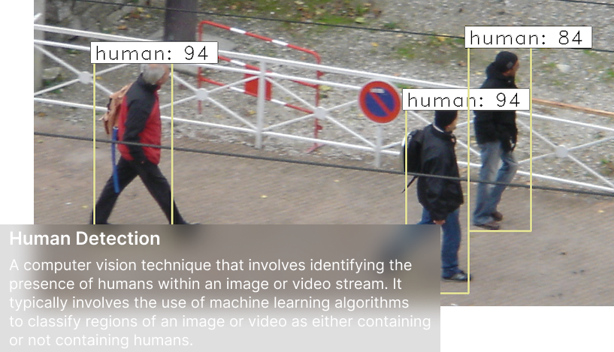
Technical details
Here are some technical details of our tools:
HOG Descriptor
Python libraries
Video Capture
CV2 (Open CV)
Human Detection
Winsound

Slide 9
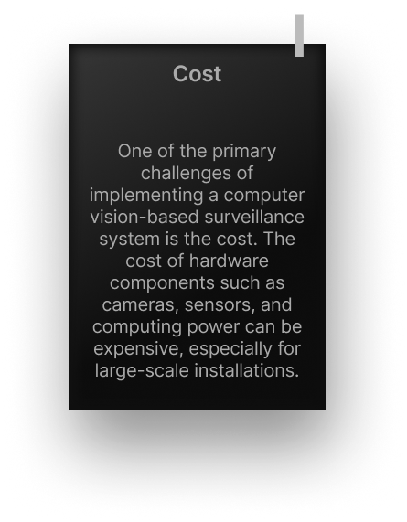
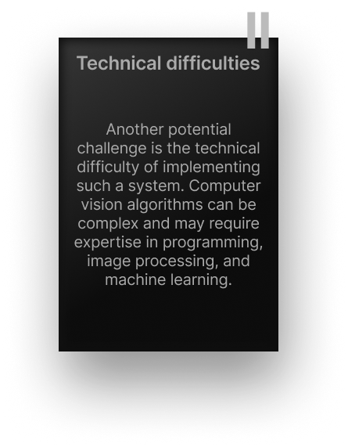


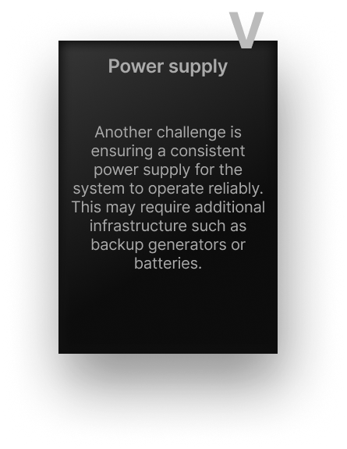
Potential changes
Even the most effective solution can present challenges, and our proposed solution is no exception. However, by identifying and addressing these challenges, we can work towards creating a robust and successful system.

Slide 10
Conclusion
In conclusion the significance of the proposed solution for a smarter India are :
The proposed solution addresses the challenges of border security, including the inability of human security agents to monitor the entire border at all times and the vulnerability of traditional fencing and barriers.
The system can be customised to suit the specific needs of individual users, with the ability to define the border of surveillance.
The proposed solution offers a cost-effective and efficient alternative to traditional border security methods.
The use of computer vision-based surveillance systems can help to improve the safety and security of communities, promoting a smarter and more secure India.
Overall, the proposed solution offers a smart and effective way to monitor border regions, ensuring the safety and security of citizens and promoting a more secure and prosperous India.

